Slide 1

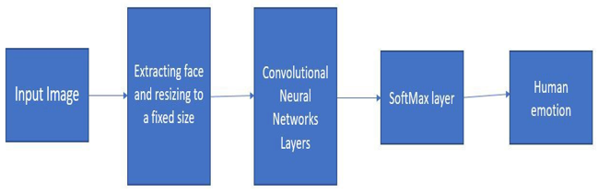
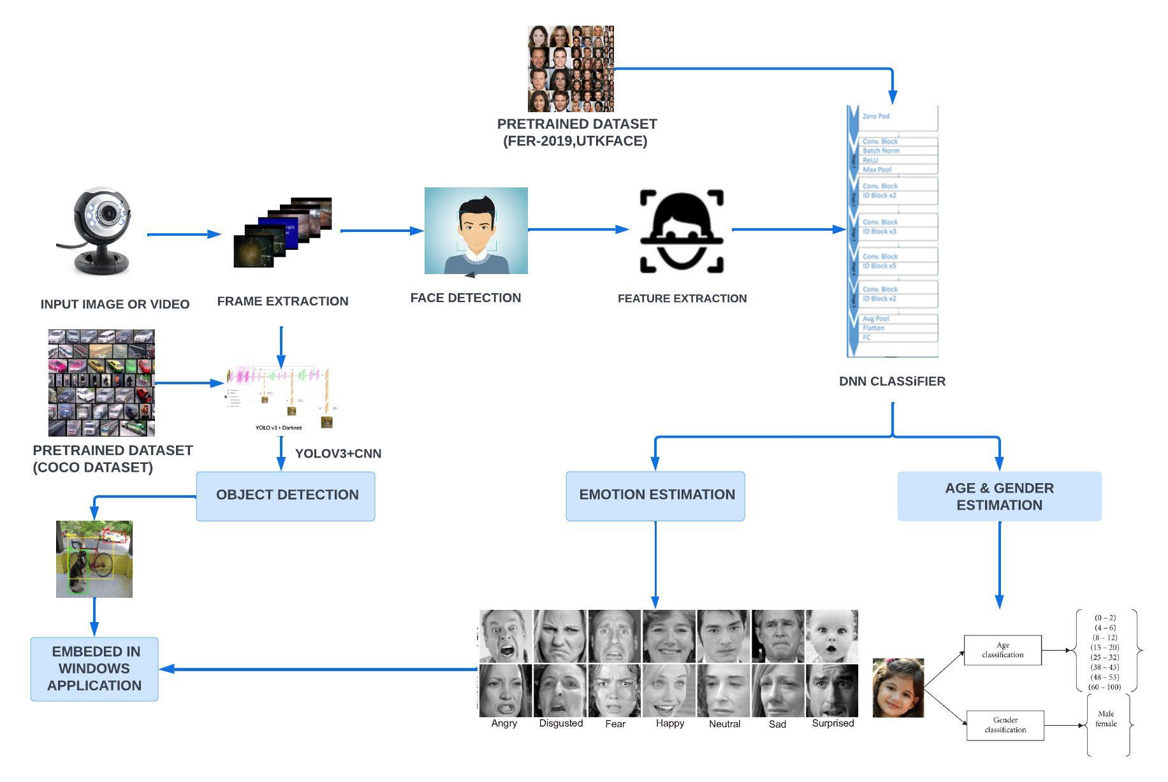
BIOMETRIC MIRROR-EXPLORING ATTITUDE TOWARDS FACIAL AND OBJECT ANALYSIS
Name of the Students: P.BHARATHI, R.GAJALAKSHMI, S.JAYAPRIYA
Dept/Yr : INFORMATION TECHNOLOGY/FINAL YEAR
Name of the Guide: Dr.A.MEIAPPANE
ABSTRACT
By combining facial emotion recognition with gender categorization, age estimation, and object identification, we hope to improve facial emotion recognition. The existing method recognises facial emotions using a Convolutional Neural Network (CNN) classifier; however, it has limitations in terms of accuracy, dataset size, and flexibility. The Proposed System is Deep Neural Network (DNN) for feature learning, which has demonstrated success in tackling complex problems, to overcome these limitations. Deep Neural Networks have achieved significant progress in the field of facial recognition. The project's goal is to identify basic human emotions such as joy, sorrow, rage, fear, surprise, and neutrality. For this, we have chosen three main datasets: COCO, which is used for object detection; UTKFace ; and FER-2013, which focuses on facial expression recognition.
EXISTING METHOD
PROPOSED SYSTEM
Advantages
Analysing facial expressions and object interactions, biometric mirrors can provide valuable insights into human behaviour . This information can be utilized in various fields, such as market research, psychology, or customer service.
It can help businesses understand consumer preferences, emotions, or engagement levels, leading to better decision-making and improved services.

